Slide 1
Homologous Chromosomes

Slide 2
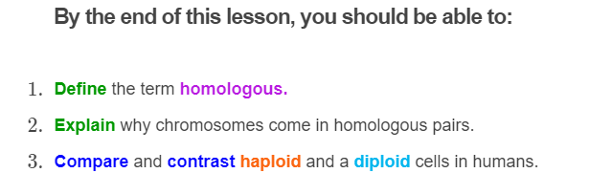


Slide 3
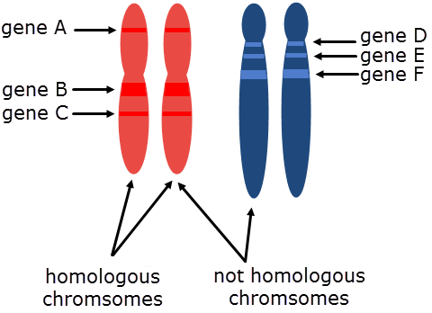
Chromosomes that carry the same genes and, as a result, are the same size, are paired together.
These pairs are called homologous pairs or homologous chromosomes.
('homo' is Greek for 'same')

Slide 4
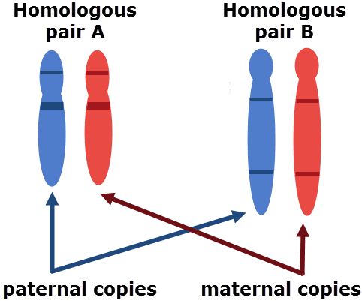
The reason you have two of each chromosome is that you inherited one from your father and one from your mother.
So in every cell you have a maternal and a paternal copy of each chromosome.
This also gives you a maternal and a paternal copy of each gene.

Slide 5
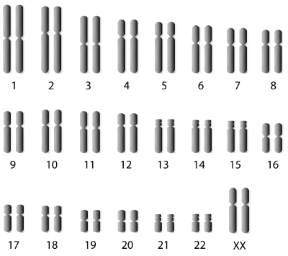
Each of your cells has two homologous copies of each chromosome: a maternal copy and a paternal copy.
We call cells with two copies of each chromosome diploid.
('di' is a Greek prefix for 'two')

Slide 6
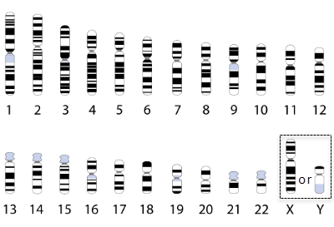
However, not all cells are diploid (contain two of each chromosome).
Some are haploid, meaning they have only one of each chromosome.
('haplos' is Greek for 'single')

Slide 7
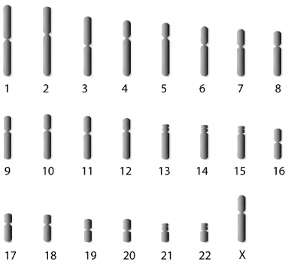
Because they have only one copy of each chromosome, haploid cells do not have homologous pairs.
They also only have 23 chromosomes compared to 46 in diploid cells.
Haploid
Diploid

Slide 8
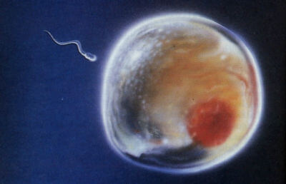
Almost all cells in the human body are diploid.
The only haploid cells in your body are your gametes.
These are specialized cells used in sexual reproduction. You would know them as sperm and ova (egg).

Slide 9
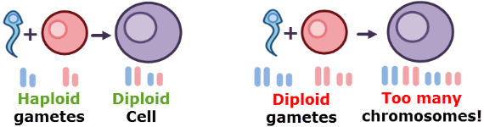
There is a reason gametes are haploid.
During reproduction, one egg and one sperm will fuse to form a single cell. This combines their chromosomes.
Because gametes are haploid, the new cell inherits one copy of every chromosome from each gamete. This makes the new cell diploid.
If gametes were diploid, the cell would inherit two copies from each gamete, resulting in too many chromosomes.

Slide 10
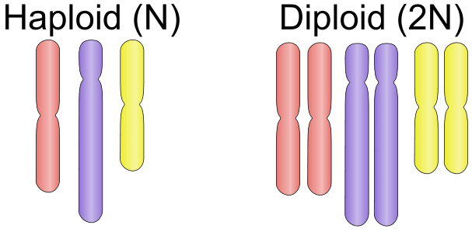
When learning about haploid and diploid, you might see the notation N and 2N.
This looks intimidating, but is actually really simple!
N represents the number of chromosomes in a cell, excluding copies. So in humans, N is 23.
When a cell has N chromosomes, this means it has one copy of each chromosome and is haploid. 2N means the cell has two copies of each chromosome and is diploid.

